Slide 1
Key Vault
Notes:
Good Evening
My name is Rihan Meij and I work at Haefele software.
I would like to tell you a bit more about key vault, and how we use it to secure our customer data

Slide 2



How do you store your passwords?
Notes:
Before we start I would like to ask you, how you store passwords that you really care about.
I am not talking about your production sql server passwords, I am talking about your personal banking passwords?
I am hoping that you at least use some sort of encryption to make sure that the bad guys cant get to your passwords.
Do we really put the same amount of effort in our production sql server passwors than we do our banking passwords?
That is where I see that key vault fits in. It is like Lastpass for your application, and just as easy.

Slide 3
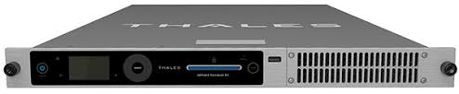
Hardware Security Module
Create Key
Encrypt
Decrypt
Cant retrieve the key
Physically tamper proof
Notes:
Before we can understand key vault we need to know a little about the mechanics of how key vault works.
At its core lies the hardware security module, this is a physical device that is installed in a data centre that contains many things to ensure the security of it.
Some of these things include light sensors, tamper sensors, special resin that the processors gets mounted in, all in a attempt to ensure the security of encryption keys.
These are the same devices that get uses in the banking industry.
At its core, you cannot ever retrieve a key once you have created or imported it. This is by design. You can however use that key for cryptographic operations like encryption and signing.

Slide 4
Key Vault
Secure storage of
Secrets
Keys
Certificates
Notes:
Secrets
25kb
Secrets are encrypted at rest with Hardware backed key
Keys
Software
Hardware backed key
Hardware
Never leaves the hardware module
Never get it out
Certificates
Contains meta data
Private key
Auto Renewal

Slide 5
Demo

Slide 6
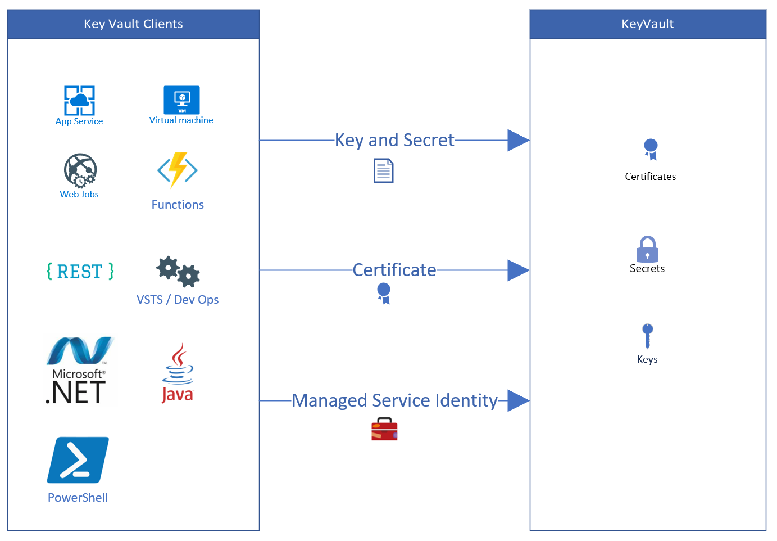
Authentication

Slide 7
Demo

Slide 8
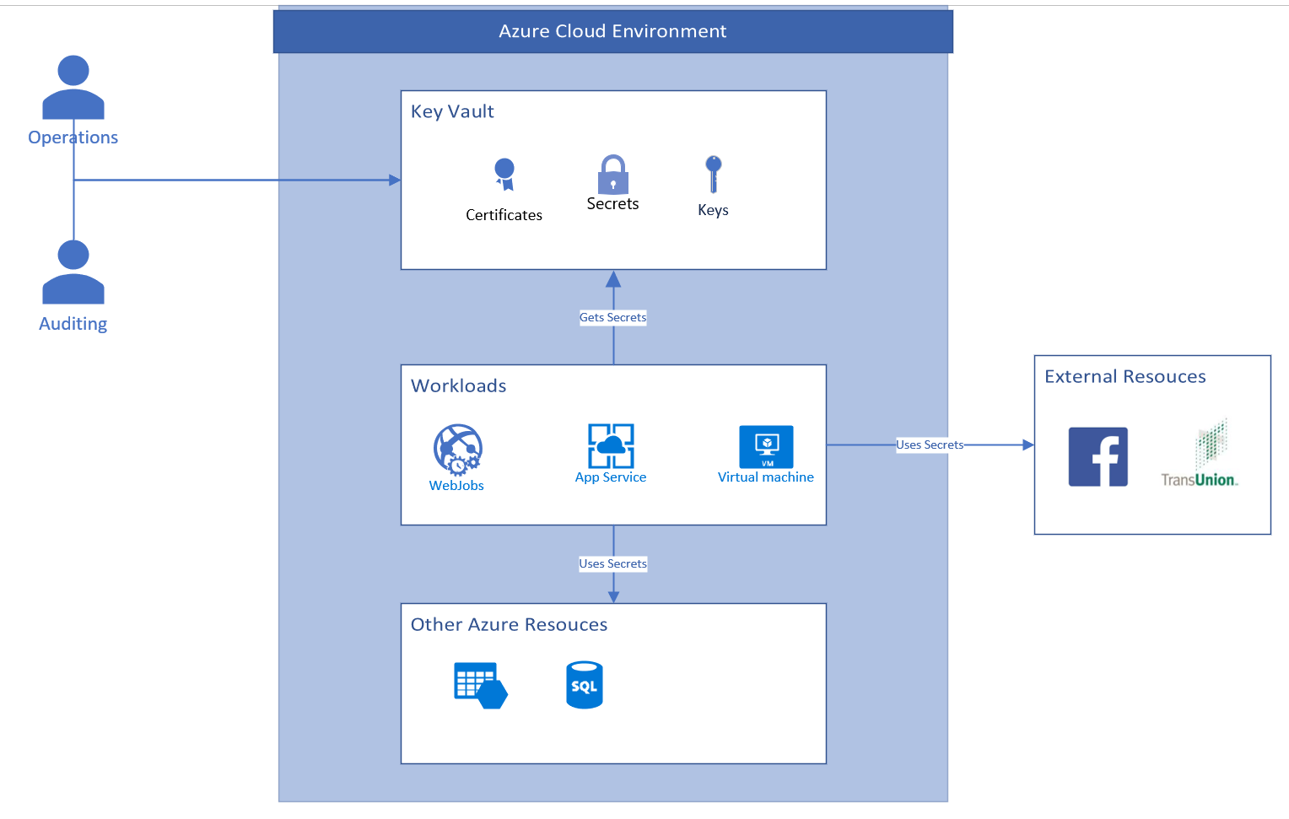
The bigger picture

Slide 9
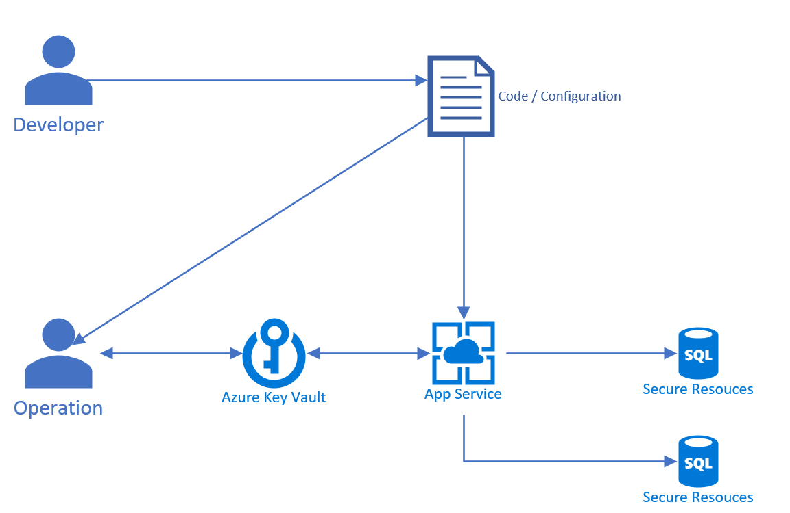
Life cycle of a secret

Slide 10
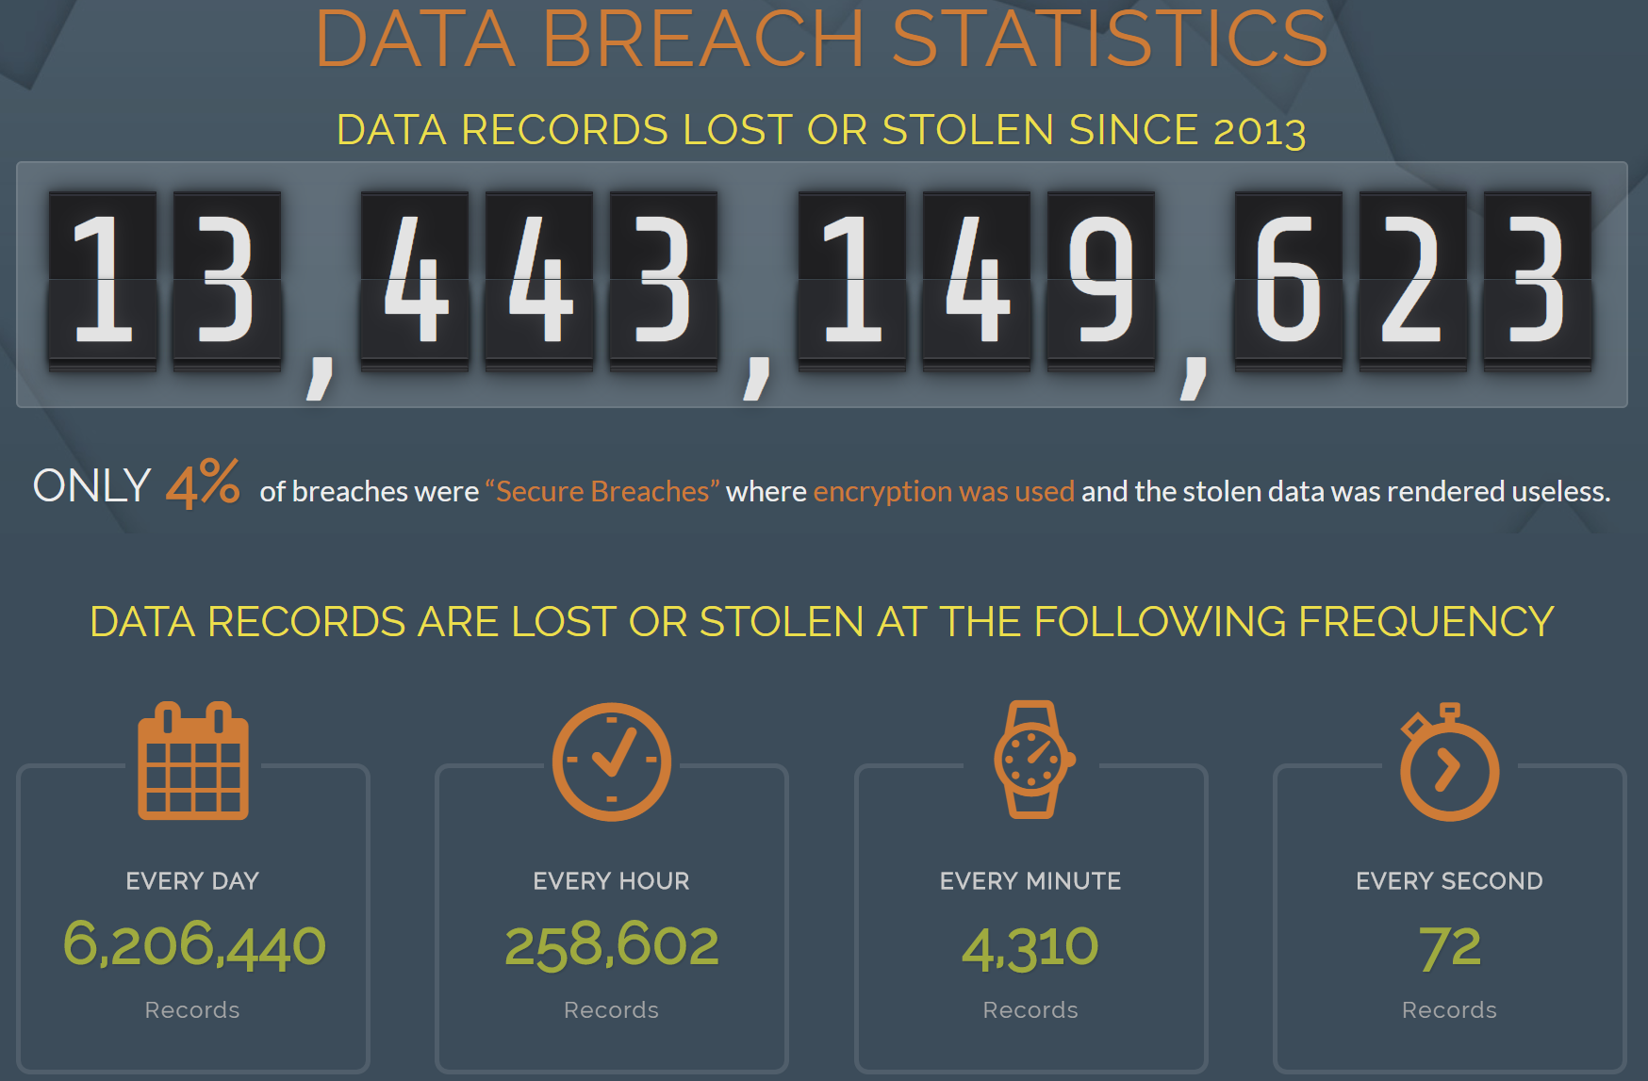
Its not case of if, but when

Slide 11
Pricing tiers
Standard | Premium
Software Protected | HSM protected
~ R0.48 per 10 000 transactions | ~ R0.48 per 10 000 transactions
 | R16 Per key per month

Slide 12
Questions?
Code and slide:
https://github.com/RihanMeij/KeyVaultDemo
Contact:
RihanMeij@gmail.com or Rihan@haefelesoftware.com

